Slide 1

Old friends, new foes: trustworthiness, quality and value in the era of Big Data
Ed Humpherson
Office for Statistics Regulation
June 2017

Slide 2
The archetypes of Big Data presentations
Archetype 1:
Big data is a universe of new opportunity
Here’s some stuff we’ve done, with cool visualisations

Slide 3

Archetype 1: It’s a universe of opportunity

Slide 4
Archetype 1: And here’s some stuff we’ve done (with cool visualisations)*
data
time
* Not an actual visualisation

Slide 5
The archetypes of Big Data presentations
Archetype 2:
Big data may be a universe of new opportunity
But there are some pitfalls

Slide 6
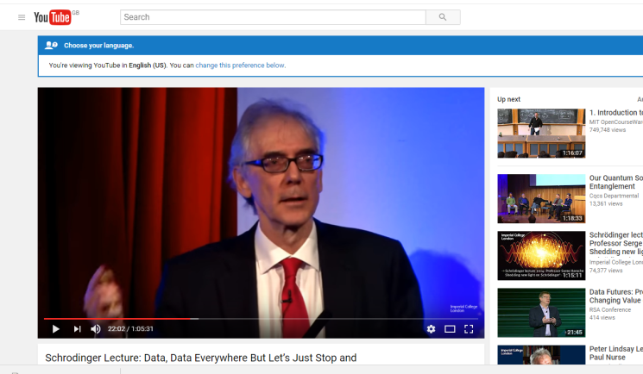
Archetype 2:
The pinnacle of the genre:
Data, data, everywhere, but let’s just stop and think
2016 Schrodinger Lecture,
David Hand

Slide 7
Archetype 2: It may be a universe…

Slide 8
Archetype 2: But there are pitfalls…
The data may be rubbish
There are new foes:
Volume of new data created
“Mathswashing”
Biased algorithms
Post truth

Slide 9
Today’s presentation – a hybrid
Some great work is being done with large data sets in Government
But there are indeed pitfalls
To maximise the opportunities and avoid the pitfalls, we use a simple framework –
  Trustworthiness
  Quality
  Value

Slide 10
How can we make sense of this mix of opportunity and threat?

Slide 11

Velocity
Volume
Variety
Validity
Volatility
Veracity

Slide 12
Our answer is different: it's simpler, and older

Slide 13
Trustworthiness
means that the data and outputs are free from vested interest.

Slide 14
Quality
means that the data outputs represent the best available estimate of what they aim to measure - and are not materially misleading.

Slide 15
Value
means that the data and outputs help answer key questions.

Slide 16
2 examples
Ordinary working families
Police recorded crime

Slide 17
Ordinary working families

Slide 18
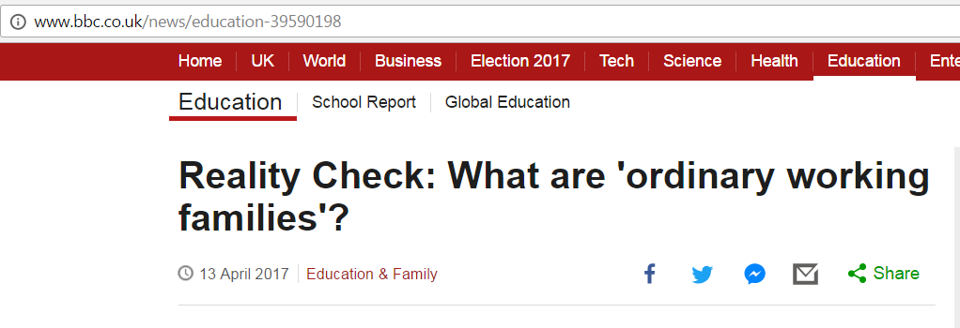

Slide 19
‘Ordinary working families’
The problem:
  No official definition of ‘ordinary working families’
  Not a census category
  Not accessible by survey
  Education data focuses on children, not families
The solution:
  Linking together a series of huge datasets
  Input from education sector and academics

Slide 20
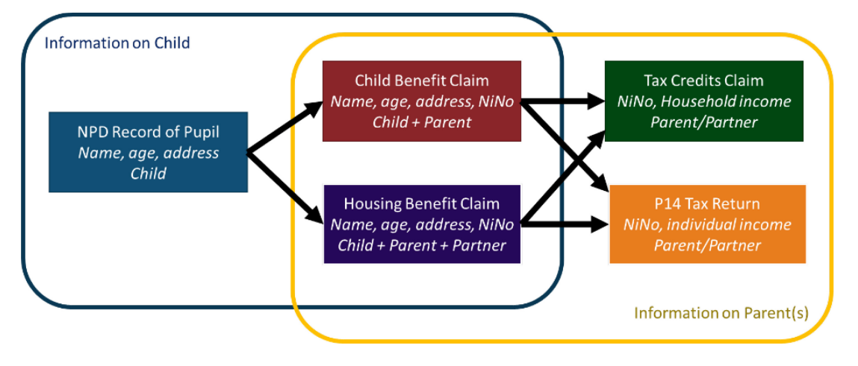
‘Ordinary working families’
The solution: Linking together:
  Children with parents/guardians AND
  Benefits claimed by parents/guardians AND
  Tax data on parents/guardians AND
  All supplemented by survey data on housing costs

Slide 21
‘Ordinary working families’
To give:
  Educational outcomes by income decile of parents
  Ordinary working families are those
    Below median income
    Not in receipt of benefits for significant disadvantage (free school meals)
  Clear protocols on anonymisation and confidentiality – an essential prerequisite for trustworthiness

Slide 22


Slide 23
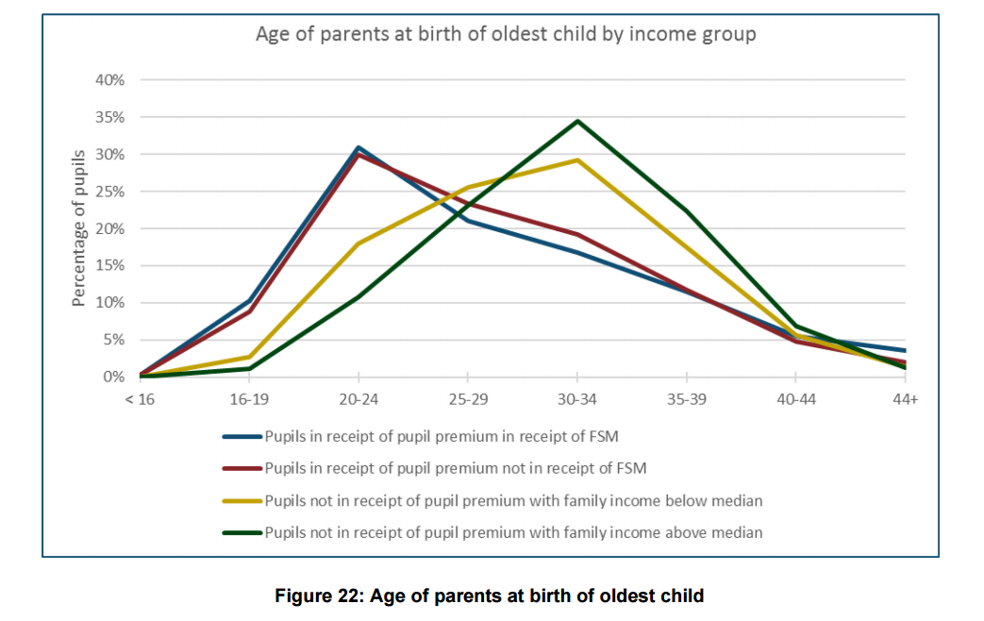
‘Ordinary working families’

Slide 24
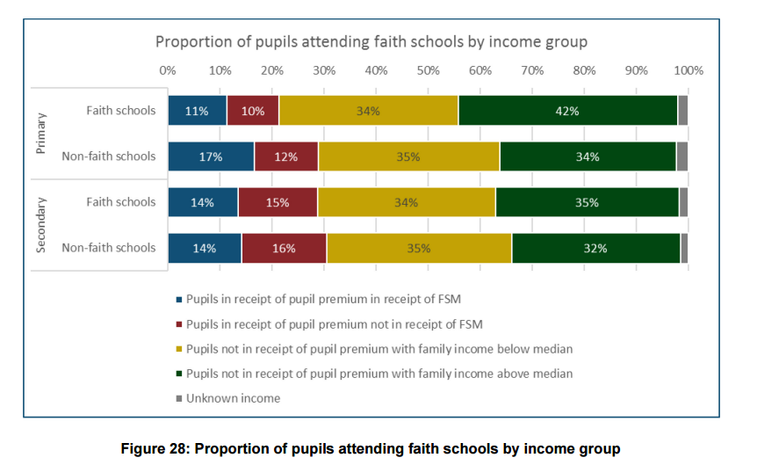
‘Ordinary working families’

Slide 25
Ordinary working families
T
Q
V
Good
Developing
Excellent

Slide 26
Police recorded crime

Slide 27
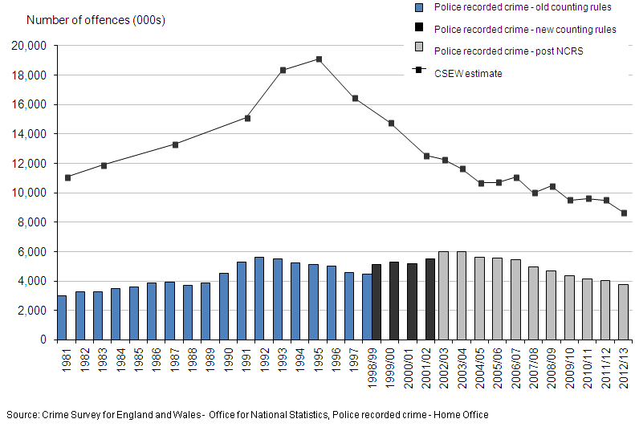
Trends in police recorded crime and the Crime Survey for England and Wales

Slide 28
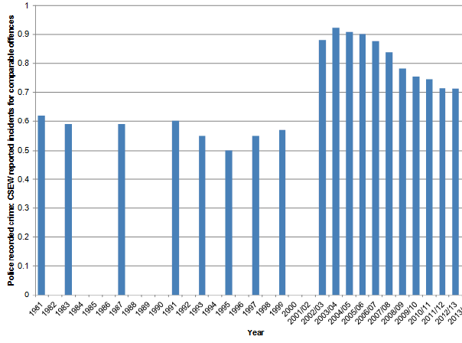
Ratio between CSEW incidents and crime recorded by the police

Slide 29
The crime recording problem
Police recorded crime in England and Wales:
We reviewed statistics on police recorded crime – and removed the National Statistics designation in Jan 2014
Subsequently HM Crime Inspectorate found:
    over 800,000 crimes may have gone unrecorded each year
    around 20% of crimes

Slide 30
Trends in police recorded crime and the Crime Survey for England and Wales
Year ending December
Year ending March
Source: ONS

Slide 31
Ratio between police recorded crime and CSEW comparable incidents
Source: ONS

Slide 32
Police recorded crime
T
Q
V
?
Low
?

Slide 33




Four practice areas associated with data quality
Admin data collection and operational context
Communication with data supply partners
Data suppliers’ QA
Statistical producers own checks

Slide 34
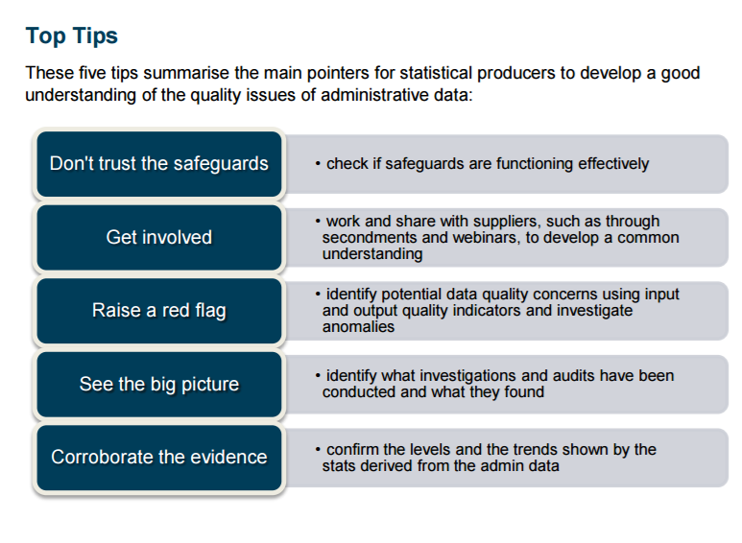

Slide 35
Big data
T
Q
V

Slide 36
Old friends of Trustworthiness,
Quality, and Value can help combat new foes in the world of big data

