Slide 1
Regulation Showcase
#OSRconf2019

Slide 2

Statistics that serve the public good
A big ask for a small organisation - how do we do this in practice?
Our vision

Slide 3
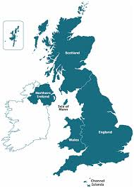
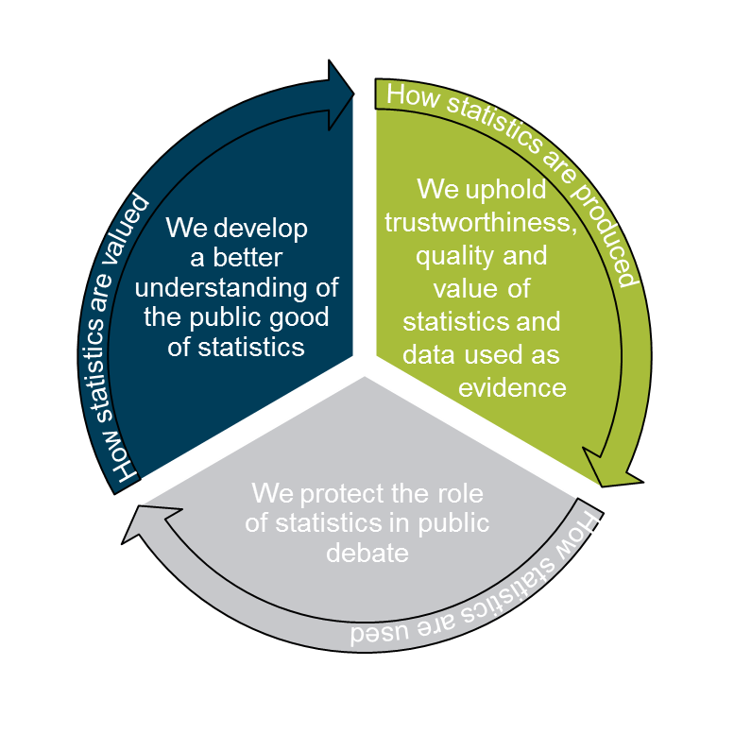
How do we do this?
Our network of three offices across the UK
Regulators with expert specialist knowledge
Work as one effective organisation
Harness our unique cross-UK viewpoint and knowledge
Through our core regulatory work we:
Edinburgh
Newport
London
  enhance public confidence in the trustworthiness, quality and value of statistics produced by government & public bodies
  Protect the role of statistics in public debate

Slide 4
What is our core regulatory work?
Our Regulatory Toolkit
Assess statistics against the Code
Assess wider value - Systemic Reviews
Support voluntary adopters
Uphold the Code of Practice
Check statistics against the Code
Stand up for statistics- comment & intervene

Slide 5
What is our core regulatory work?
Our Regulatory Toolkit
Assess statistics against the Code
Assess wider value - Systemic Reviews
Support voluntary adopters
Uphold the Code of Practice
Check statistics against the Code
Stand up for statistics- comment & intervene

Slide 6
What is our core regulatory work?
Our Regulatory Toolkit
Assess statistics against the Code
Assess wider value - Systemic Reviews
Support voluntary adopters
Uphold the Code of Practice
Check statistics against the Code
Stand up for statistics- comment & intervene

Slide 7
What is our core regulatory work?
Our Regulatory Toolkit
Assess statistics against the Code
Assess wider value - Systemic Reviews
Support voluntary adopters
Uphold the Code of Practice
Check statistics against the Code
Stand up for statistics- comment & intervene

Slide 8
What is our core regulatory work?
Our Regulatory Toolkit
Assess statistics against the Code
Assess wider value - Systemic Reviews
Support voluntary adopters
Uphold the Code of Practice
Check statistics against the Code
Stand up for statistics- comment & intervene

Slide 9
What is our core regulatory work?
Our Regulatory Toolkit
Assess statistics against the Code
Assess wider value - Systemic Reviews
Support voluntary adopters
Uphold the Code of Practice
Check statistics against the Code
Stand up for statistics- comment & intervene

Slide 10
Our impacts and outcomes
How our work ensures that statistics serve the public good
Regulators from across our three sites
Working across the UK as one
Working with our full toolkit under one mission
Delve more into how we go about upholding the trustworthiness, quality and value of statistics
Impact and outcomes showcase

Slide 11

Air quality and emissions of air pollutants
Source: https://www.scitecheuropa.eu/serious-air-pollution/83486/

Slide 12
Air quality and emissions of air pollutants
Assessment report published July 2019, Defra to report back by May 2020
These widely used data and statistics are vital to supporting public understanding of air pollution and informing debate and policy
VALUE | Both sets of statistics will be better integrated Bringing together local and national data will generate greater insight Better engagement with users will support better understanding of the data and statistics
QUALITY | Reassures users that most appropriate data sources and methods are used Providing more information about quality and methods will help users better understand data
TRUSTWORTHINESS | Defra continuing to commit resource to development and publish development plan

Slide 13

Devolved Public Finances
www.statisticsauthority.gov.uk/publication/the-public-value-of-devolved-public-finance-statistics

Slide 14
Devolved Public Finances
Systemic review and Assessment of Government countries and regions spending statistics published May 2019
The statistics tell us how taxes are used to fund public services in the regions and countries of the UK. Once our recommendations implemented, users in the regions and countries will
  be able to more easily compare spending on programmes and services for their region / country against others
  be able to hold the UK government and their devolved administrations to account for the fairness of the funding and outcomes of the spending
  hold new city-region authorities to account for public funding and spending
  see how central government block grants are calculated and distributed to devolved countries
  benefit from improved independent fiscal / economic forecasting
  be more assured of the long term fiscal sustainability

Slide 15

Housing & Planning Statistics (UK wide)

Slide 16
Housing & Planning Statistics (UK wide)
2017 systemic review, currently we are monitoring progress
Our review highlighted issues around
accessibility and coherence, evidence gaps, lack of quality assurance, limited user engagement, a need for added insight and collaboration
Our impact
New outputs on UK homelessness
UK housing affordability
UK housing conditions
Private rental sector rent levels
https://gss.civilservice.gov.uk/user-facing-pages/housing-and-planning-statistics/

Slide 17

Adult Social Care Statistics

Slide 18
Adult Social Care Statistics (UK wide)
Ongoing systemic review
We explored stakeholders’ needs for statistics about adult social care in England, Northern Ireland, Wales and Scotland
In the immediate term, we are encouraging producers to:
  investigate unstructured data sources
  link data from other sectors
  provide comprehensive sector analysis
In the long term, widespread technological improvements are needed to capture data at the point of care for decision-making, research and statistics

Slide 19

Migration

Slide 20
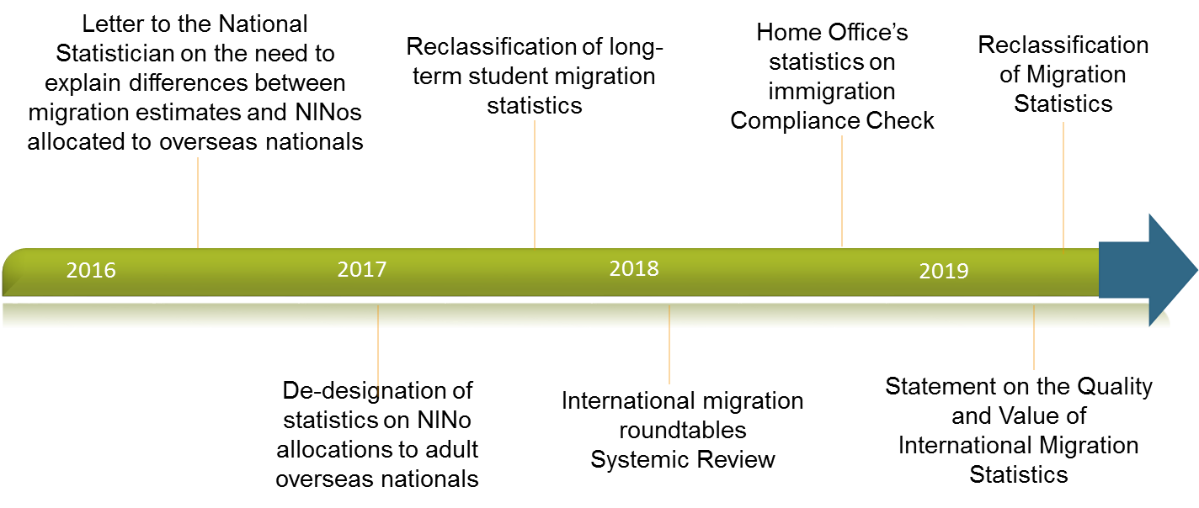
Migration our ongoing push for statistical improvements

Slide 21

National Statistics
Code of Practice for Statistics
Code stocktake
“National Statistics” – 21 years old
  Exploratory review – what does the designation mean to stakeholders today?
  Report on our findings by end of the year and plans for next steps

Slide 22
Voluntary Adoption
“We aspire to further our commitment to the Code by publishing more details on our analytical methods, and by continuing to innovate in visualising our data, to expand its accessibility.” UCAS
“By voluntarily applying the Code our hope is that this will give confidence to those using the statistics and aid our ambition for the survey results to be the used across the whole sector by a variety of organisations including Government, Consumer Groups and Firms.” FCA

Slide 23
Questions and answers
Better understanding of the tools we have as regulators
Range and reach of our influence
How our work helps us uphold trustworthiness, quality and value
Part of our planned work - publicised via our work programme
All our published and planned work www.statisticsauthority.gov.uk/osr

